Slide 1
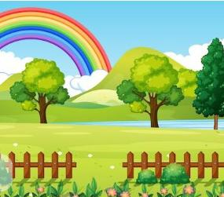
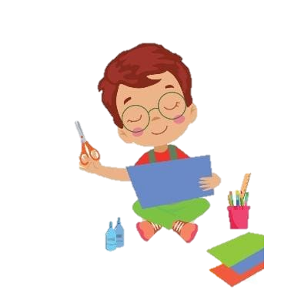
“The Paper heart”
Its Ayaan’s mother birthday . he didn’t have money for gift but he has paper and love .
A little boy Ayaan sitting quietly , folding a small red paper heart for his mom.

Slide 2
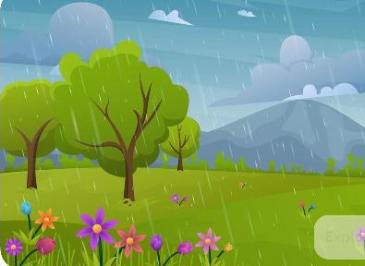
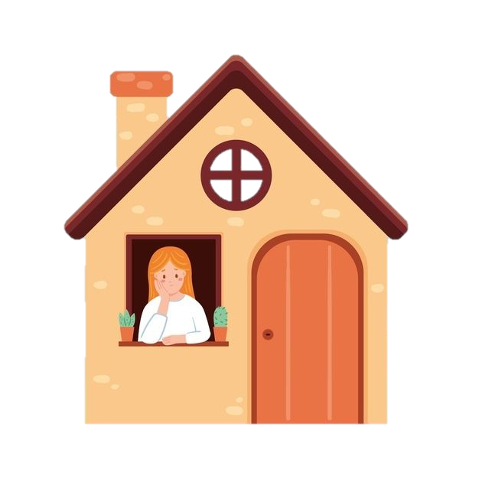
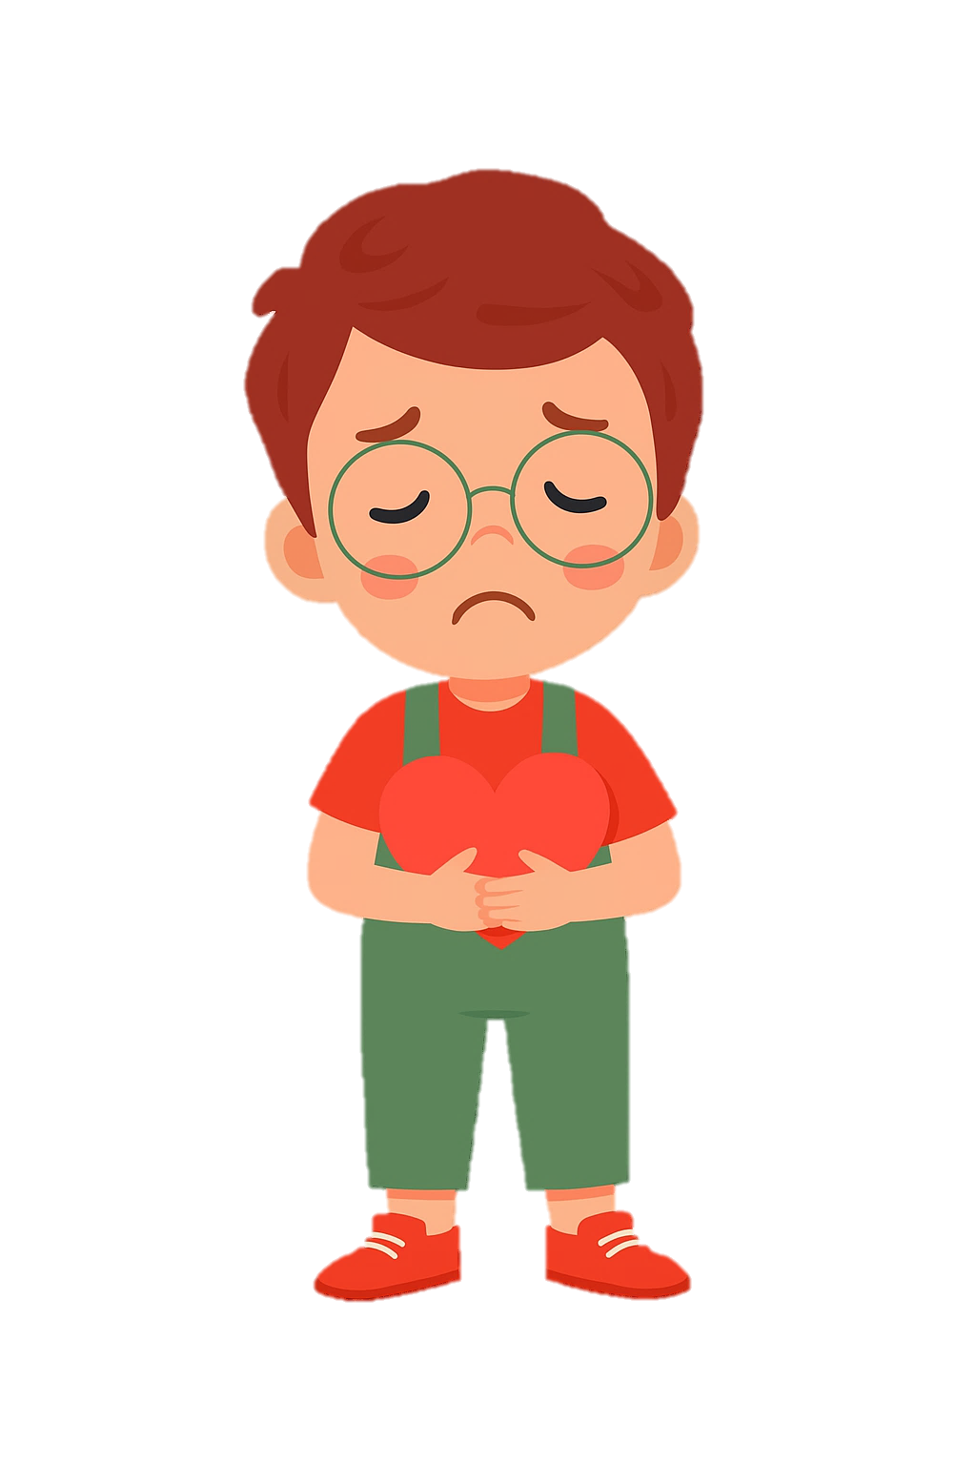
Suddenly, wind blow and start rain. He runs home in the rain, clutching the paper heart to his chest. Suddenly, wind snatches it away! “No! my heart.”
Hihis mother is watching him from window .

Slide 3
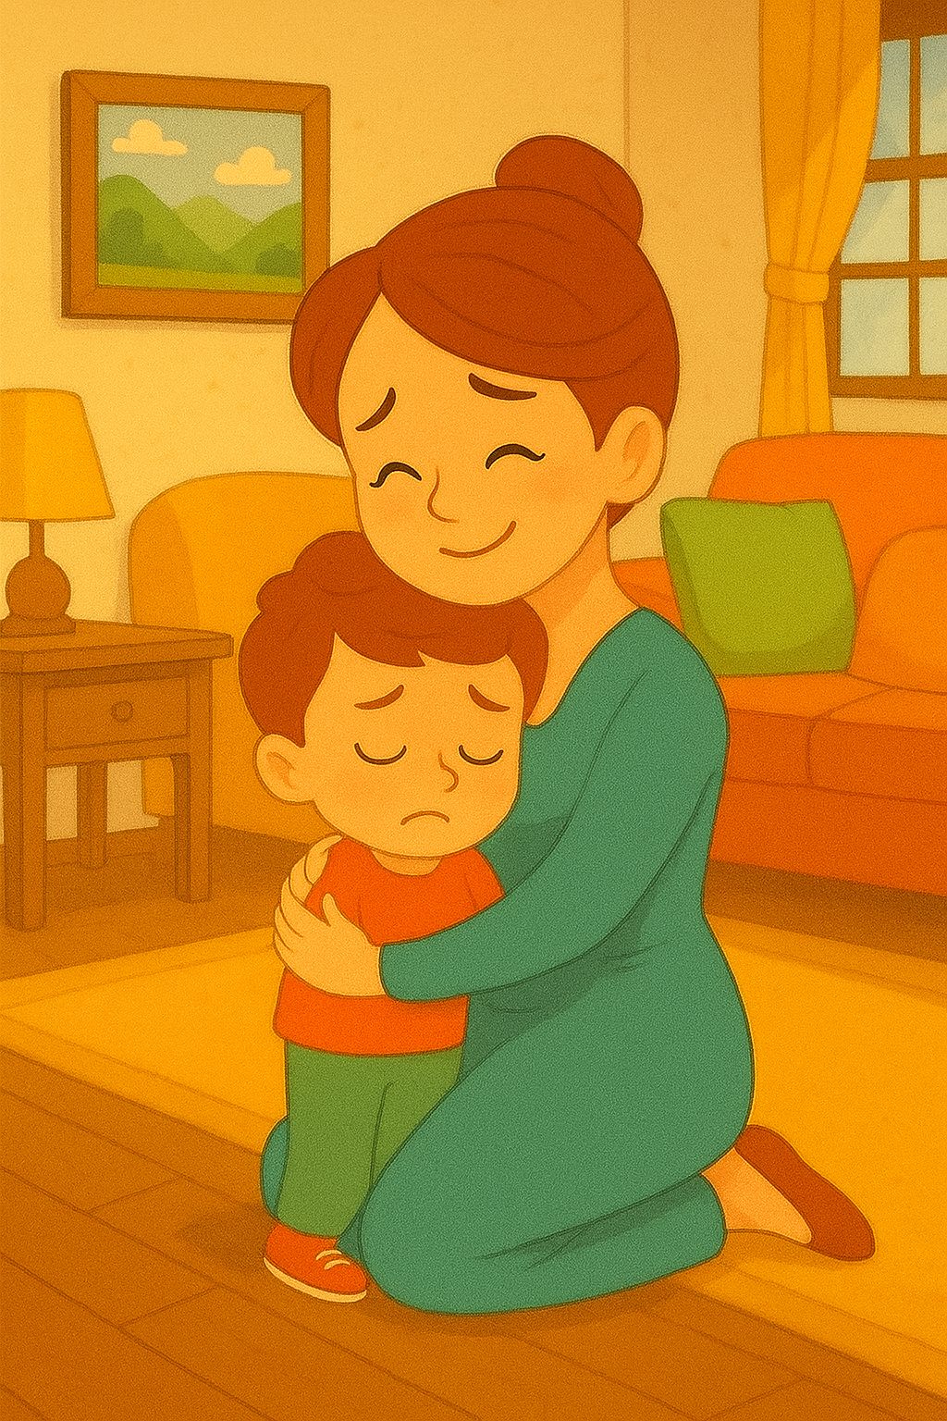
It’s okay, sweetheart. You already gave me your heart… right here.
Ayaan reaches home, tearful. His mother kneels and hugs him tightly

Slide 4



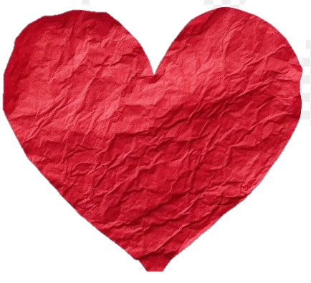
The next morning, a dried, wrinkled paper heart sits on the windowsill — sunlight shining through it.
“The best gifts can’t be wrapped— only felt.”

